Slide 1
Madura HRMS: The Future of Workforce Management
Presented by: Madura Solutions / Sachin K C
https://hrms-delta-eight.vercel.app

Slide 2
Problem Statement
Disconnected HR systems (Attendance, Payroll, Finance)
Legacy UI reducing user adoption
Manual processes (Excel, Tally dependency)
Communication gaps using external tools
Business Impact:
  Productivity loss
  Data inconsistency
  Increased operational cost

Slide 3
Solution Overview
Unified HRMS + ERP + Communication platform
Fully automated employee lifecycle
Real-time updates & notifications
Modern SaaS-grade UI

Slide 4
System Architecture
Architecture: Modular Monolith
Frontend: React + Vite (SPA)
Backend: Node.js + Express
Real-time: Socket.io
Storage: MongoDB Atlas

Slide 5

Tech Stack
Frontend
React 19, Vite, Recharts
Context API
Backend
Node.js, Express
Node-Cron
Database
MongoDB (Mongoose ODM)
Integrations
Zoom API
Nodemailer

Slide 6

Core Features
Smart Attendance (calendar tracking)
Automated Payroll Engine
Internal Messaging System
AI Chatbot (engagement)
IT Support Ticketing

Slide 7
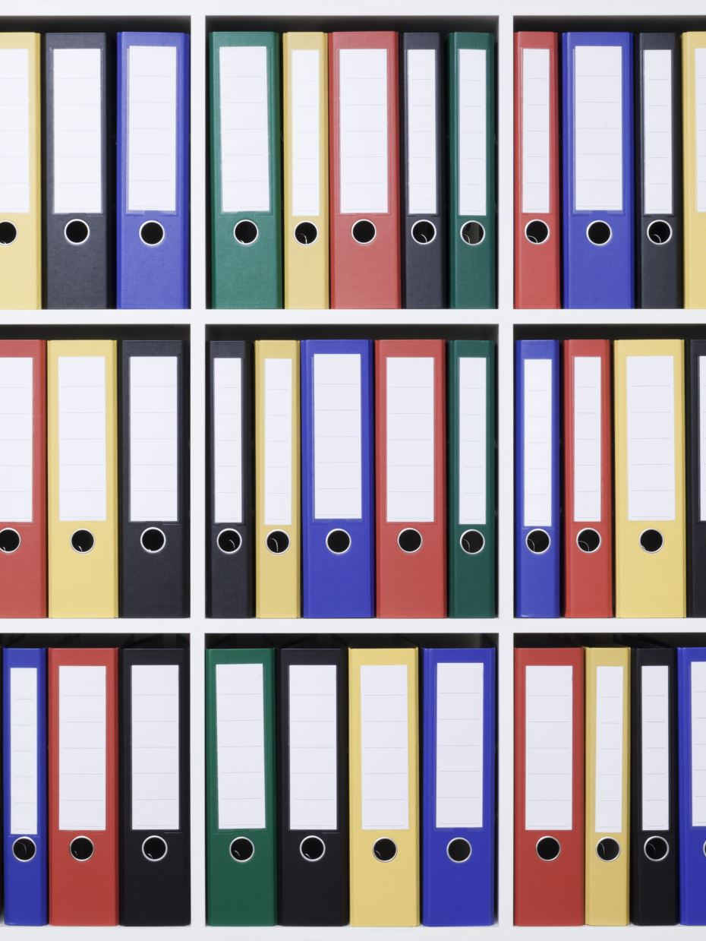
User Roles & Workflow
Roles
  Admin / HR Manager → Full access
  HR Executive → Operations
  Finance → Accounting modules
  Employee → Self-service
Workflow Example
Login → Clock-in → Attendance → Payroll → Payslip → Notification

Slide 8
Database & API Design
Database
25+ collections
Indexed audit logs
Scalable schema
API
RESTful design
JWT authentication
RBAC authorization
Input validation

Slide 9
Performance, Security & Testing
Performance
  Vite optimization (fast builds)
  Lazy loading
Security
  Bcrypt hashing
  JWT + secure cookies
  Rate limiting
Testing
  Unit (Jest)
  API (Postman)
  Future: Playwright E2E

Slide 10
Conclusion & Future Scope
Impact
40% reduction in manual HR work
60% faster internal communication
Future Enhancements
Recruitment pipeline

Slide 11
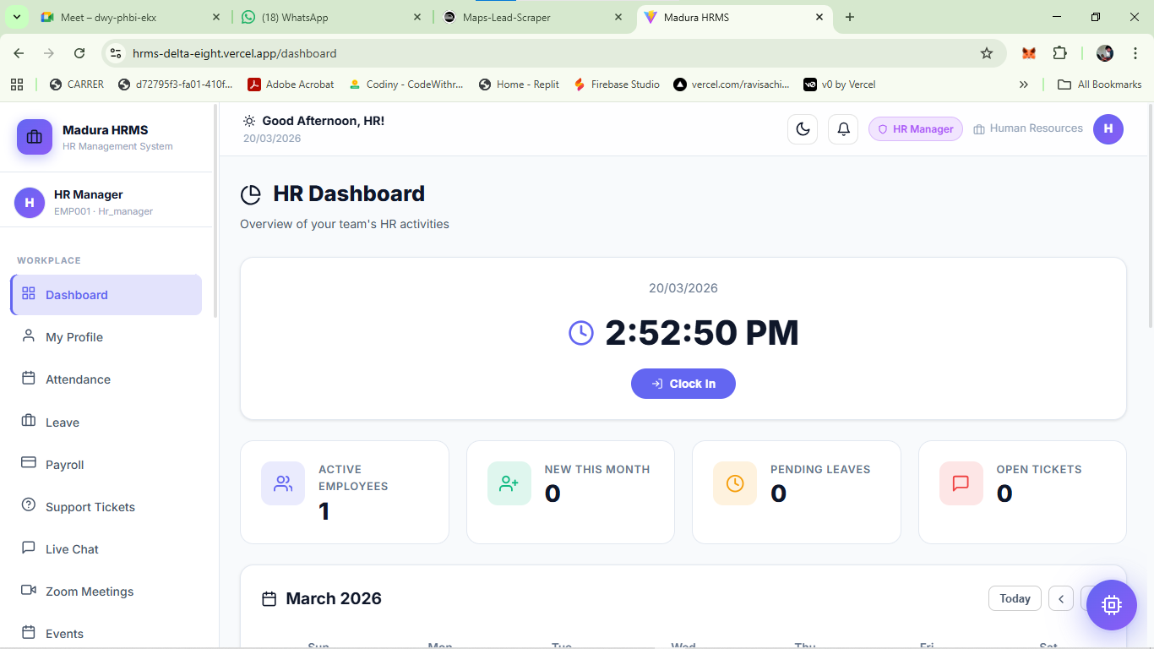
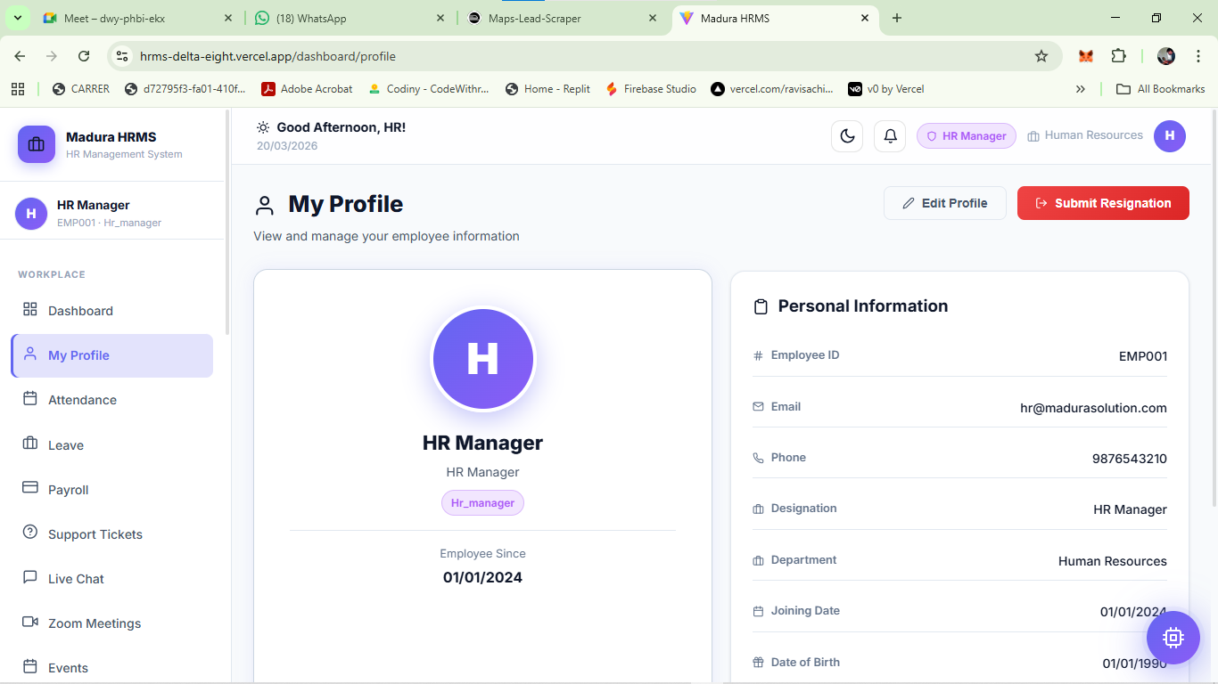
screenshot

Slide 12
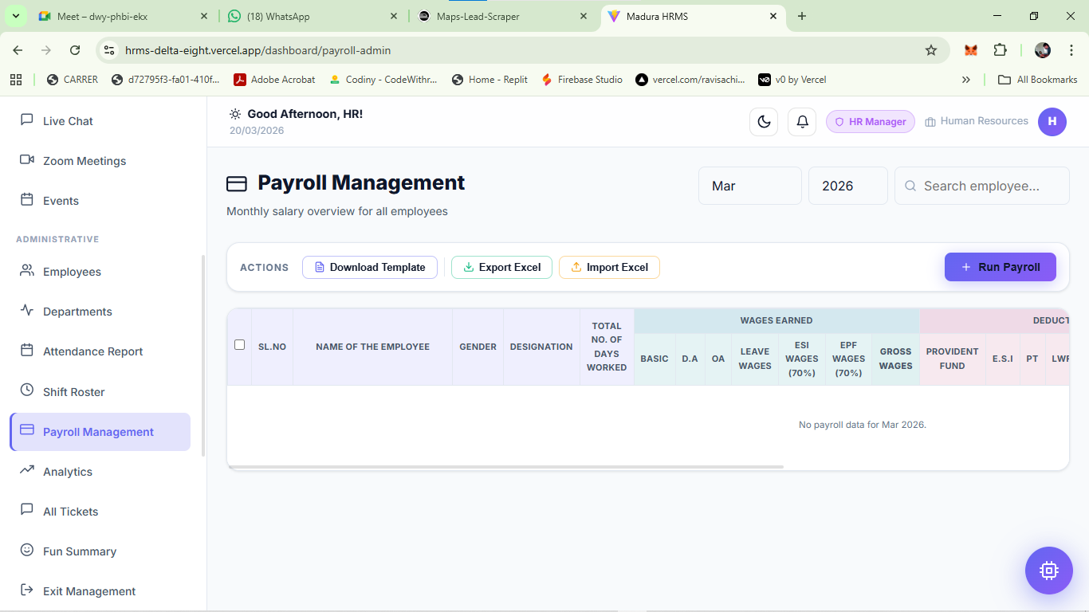
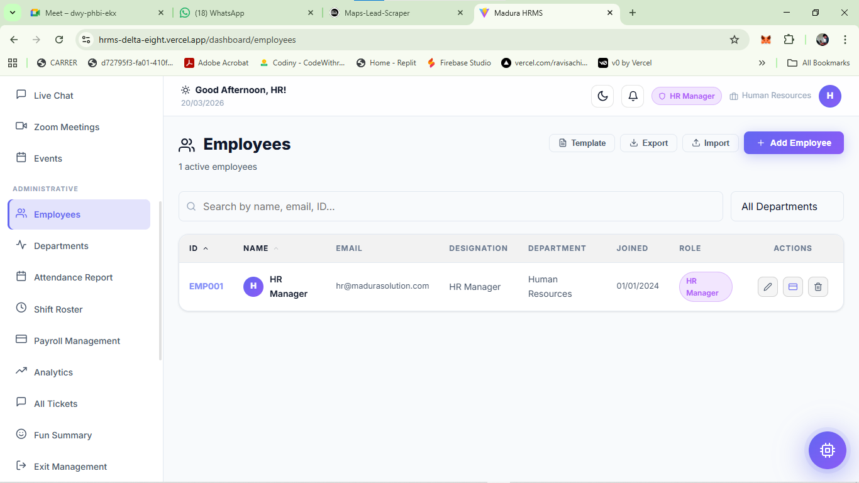
screenshot

Slide 13
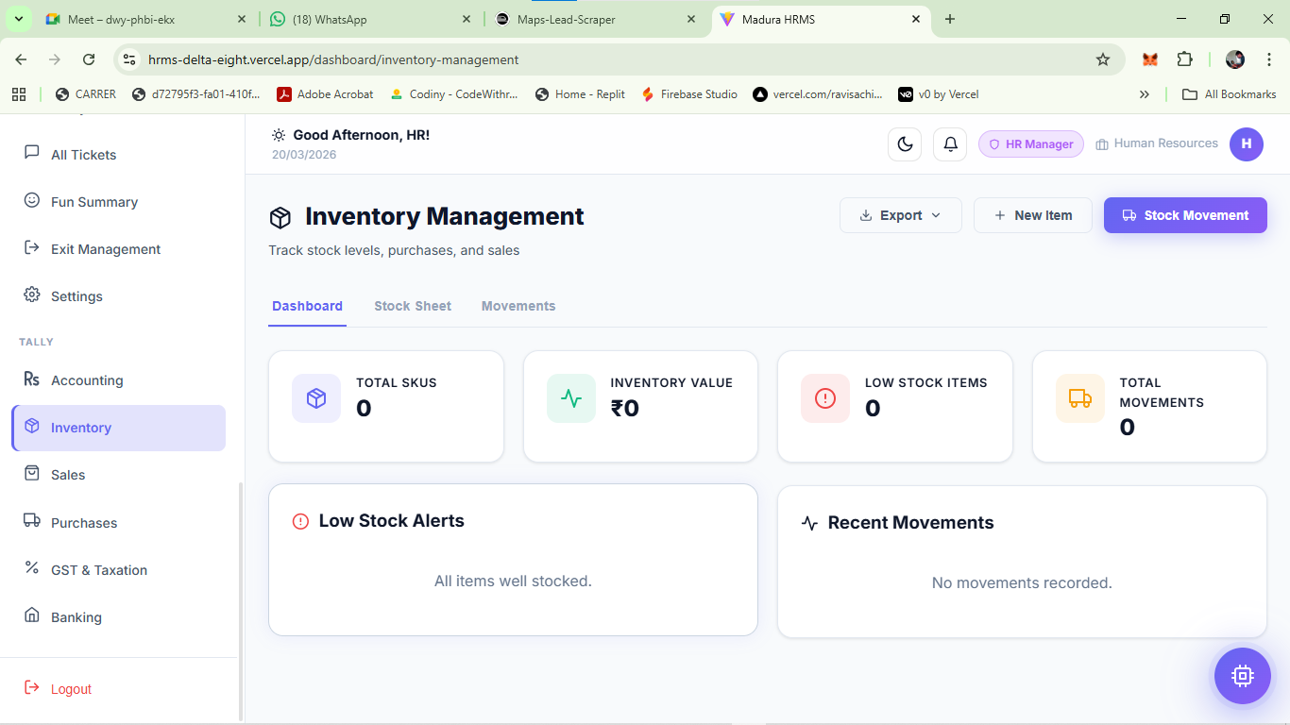
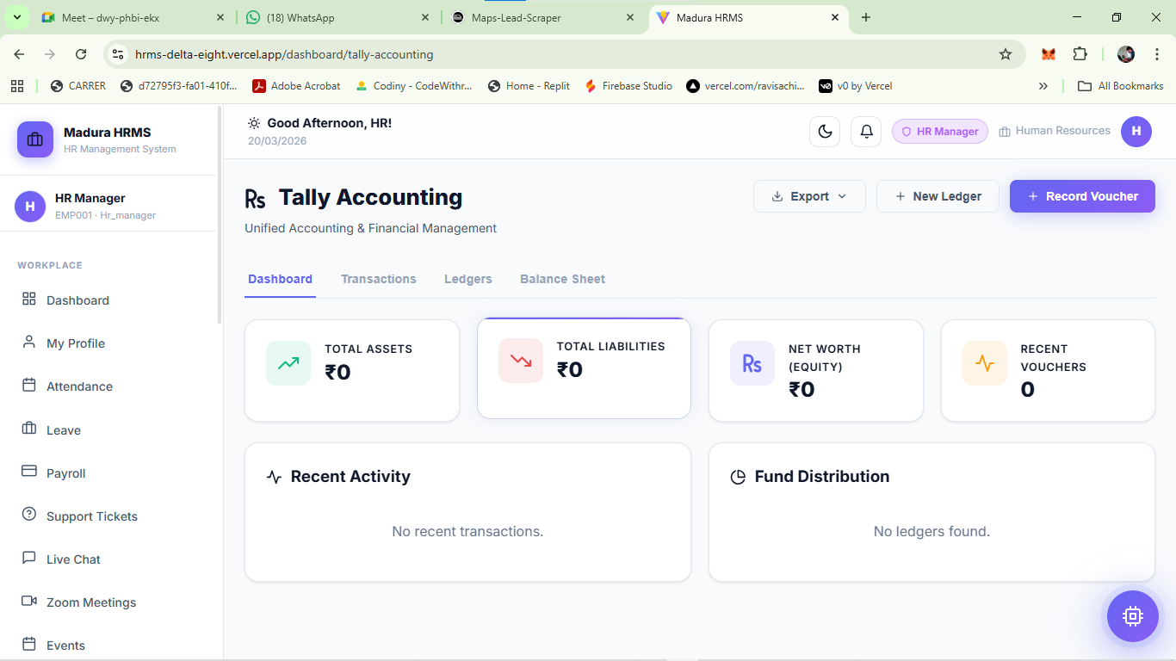
screenshot

